Slide 1
How Animals Adapt to Changes in their Environments
(https://serendipstudio.org/exchange/bioactivities/evoadapt)

Slide 2
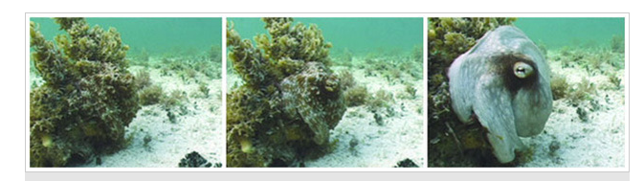
An Octopus Emerges from Camouflage

Slide 3
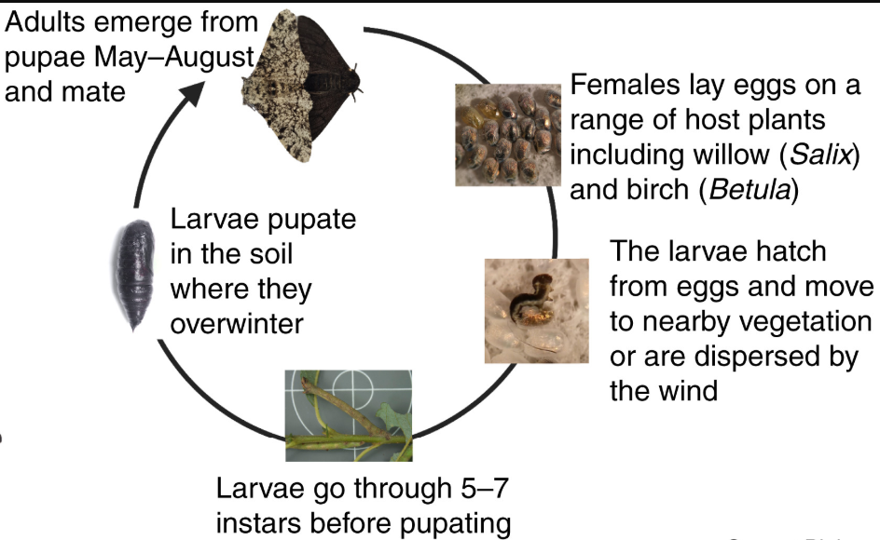
Larvae = caterpillars; each instar before the last ends with a molt to the next larger instar; the largest instar pupates to produce an adult peppered moth.

Slide 4
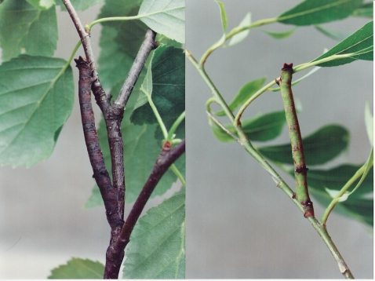
Peppered Moth Caterpillars on
Brown Birch and Green Willow Branches

Slide 5
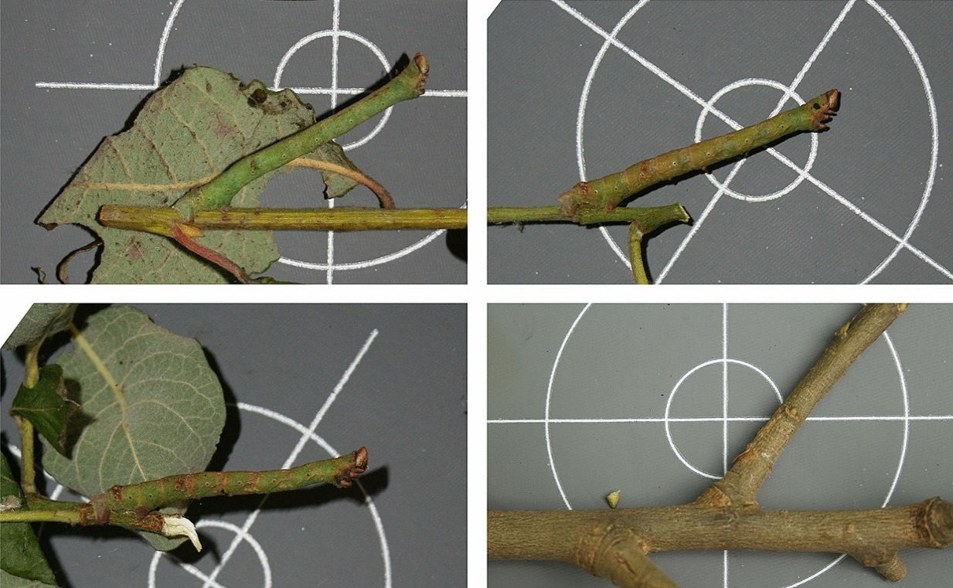

A peppered moth caterpillar mimics a twig.

Slide 6
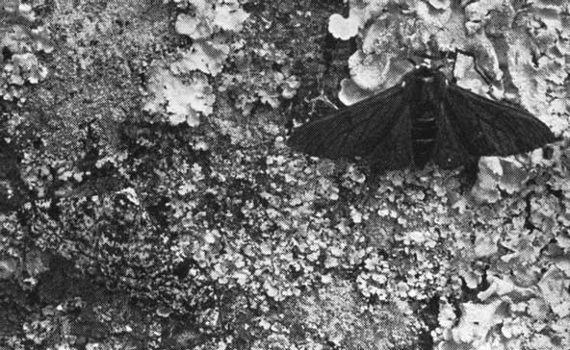
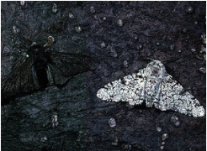
Adult Peppered Moths on Lichen-covered and Soot-covered Tree Trunks

Slide 7
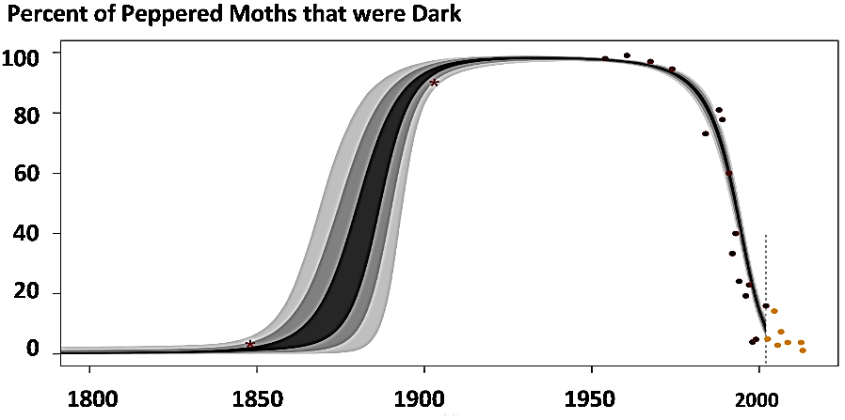
Trends in an Industrial Region in England

Slide 8
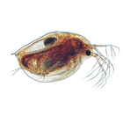
Daphnia

